Slide 1



Geoff and Garrett’s Game Show Extravaganza
Host: Garrett
Technician: Geoff
P1:
Player 1 Name
Player 2 Name
Player 1 Score
Player 2 Score
Socket ID: ###########
IP Address: ###########
P3:
Player 2 Name
Player 4 Name
Player 2 Score
Player 4 Score
Socket ID: ###########
Player Modifiers
IP Address: ###########

Slide 2
Geoff and Garrett’s Game Show Extravaganza
Host: Garrett
Technician: Geoff
P1:
Player 1 Name
Player 2 Name
Player 1 Score
Player 2 Score
Socket ID: ###########
IP Address: ###########
Player Modifiers

Slide 3
Chat Window
Tree structure to select game/questions/content
Start Game
Update Names
Update Scores
Deploy Pic
Summon Leprechaun
Sharks!
P1:
Player 1 Name
Player 2 Name
Player 1 Score
Player 2 Score
Socket ID: ###########
IP Address: ###########
What the players see (For Garret)
Debug/Status info (For Geoff)
P3:
Player 2 Name
Player 4 Name
Player 2 Score
Player 4 Score
Socket ID: ###########
Player Modifiers
IP Address: ###########

Slide 4
Tree structure to select game/questions/content
Start Game
Chat Window
End Game
Update Names
Update Scores
Deploy Pic
Summon Leprechaun
Sharks!
P1:
Player 1 Name
Player 2 Name
Player 1 Score
Player 2 Score
Socket ID: ###########
IP Address: ###########
What the players see (For Garret)
Debug/Status info (For Geoff)
P3:
Player 2 Name
Player 4 Name
Player 2 Score
Player 4 Score
Socket ID: ###########
Player Modifiers
IP Address: ###########

Slide 5
Chat Window
Tree structure to select game/questions/content
PLAY!
Deploy Pic
Summon Leprechaun
Sharks!
Player 1 Name
PlayerID | Name | score | socketID | ipAddress
Player 2 Name
Player 1 Score
Player 2 Score
Update Names
Update Scores
Request Data Update
Mock Console Window
Player 2 Name
Player 4 Name
Player 2 Score
Player 4 Score

Slide 7


Welcome to Geoff and Garry’s Game Show Extravaganza!
Some words of encouragement/ our catch phrase
Please enter your name:
I am Geoff
I am Garrett

Slide 8

Player 1 Name
Player 2 Name
Player 1 Score
Pass the Conch
Player 2 Score
Would it be better to be a gecko or a hawk for 1 week?
Accumulated Silence:
Conversation Length:
Player 2 Name
Player 4 Name
Player 2 Score
Player 4 Score

Slide 9


Player 1 Name
Name the Animal
Player 2 Name
Player 1 Score
Player 2 Score
Player 2 Name
Player 4 Name
Player 2 Score
Killer Whale
Player 4 Score

Slide 10

Topic scroll list
Start Timer
Reset Timer
Show Prompt
Player 1
Player 2
Player 3
Player 4
Player 1 Name
Definitely Not Pictionary
Player 2 Name
Player 1 Score
Time Left:
Player 2 Score
Artist: (player Name) or Prompt
Player 2 Name
Player 4 Name
Player 2 Score
Player 4 Score

Slide 11


Slide 12
Left Side
Start
Pause
Reset
Right Side
Name select
Name select
Freeze Paddlle
Freeze Paddlle
Release Paddle
Auto Freeze Opponent
Release Paddle
Pressure Pong
Player 1 Name
Player 2 Name
Player 1 Score
Player 1
Player 2
Player 2 Score
Prompt very long text
Player 2 Name
Player 4 Name
Player 2 Score
Player 4 Score

Slide 13
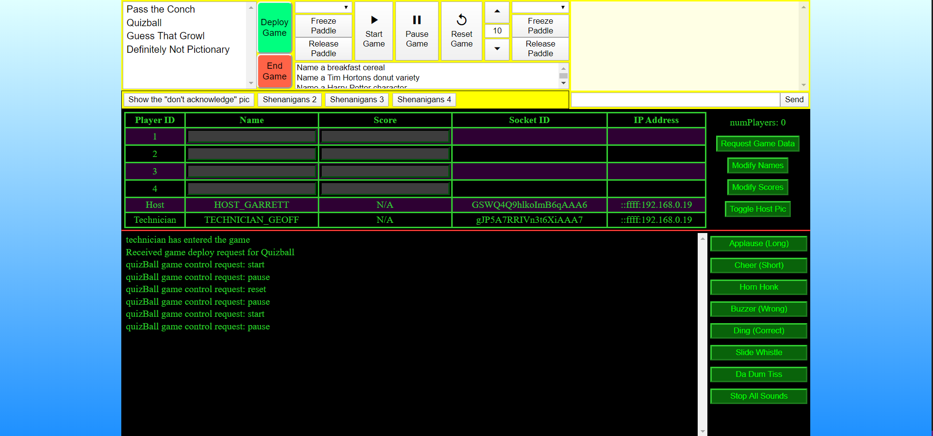
Left Side
Start
Pause
Reset
Right Side
Name select
Name select
Freeze Paddlle
Freeze Paddlle
Release Paddle
Auto Freeze Opponent
Release Paddle
Player 1 Name
Player 2 Name
Player 1 Score
Player 2
Player 2 Score
gameState | ballSpeed
reset | 10

Slide 14





Slide 15


Slide 16


Slide 17


Slide 18


Slide 19


Player Request
Player lands on index, clicks “join game”
playerRequest
newObserver
playerListChanged
Player successfully added to game, broadcast to ALL sockets
playerName = AUDIENCE_MEMBER
Broacast to ONLY the socket trying to join

Slide 20
Audience Request
Player lands on index, clicks “Watch as Audience”
playerName = AUDIENCE_MEMBER
audienceRequest
newObserver
Broacast to ONLY the socket trying to join

Slide 21
Host Request
Host lands on index, clicks “I am Garrett”
playerName = HOST_GARRETT
hostRequest
HostSocketID is recorded
newCastMember
Broadcast to ONLY the socket trying to join

Slide 22
Technician Request
Technician clicks “I am Geoff”,
playerName = “TECHNICIAN_GEOFF”
technicianRequest
technicianSocketID is recorded
newCastMember
Broadcast to ONLY the socket trying to join

Slide 23
Player Leaves Game
Player refreshes/closes the tab
leaveGame
playerListChanged
Name = null, numPlayers -= 1
broadcast to ALL sockets

Slide 24
Cast Sends Message
Host clicks ‘send’
‘sender’ is specified
messageRequest
ONLY BROADCAST TO CAST MEMBERS
messageDelivery
sender: HOST_GARRETT or TECHNICIAN_GEOFF

Slide 25
Technician Transactions
Technician clicks ‘request current data’
gameDataRequest
technicianSoundRequest
technicianSoundStopRequest
technicianSoundDelivery
gameDataDelivery
technicianSoundStopDelivery
Only sent to technician

Slide 26
Technician change names/scores
Technician clicks relevant button
nameChangeRequest
Or scoreChangeRequest
playerListChanged
OR
playerScoresChanged

Slide 27
Cast member wants to start/end a game
Cast member clicks relevant button from host header
gameStartRequest
Or
gameEndRequest
gameStarting
OR
gameEnded

Slide 28
Conch Game
Click ‘deploy prompt’
conchConvoStartRequest
conchPromptRequest
conchConvoStoptRequest
conchSilenceStartRequest
conchSilenceStopRequest
conchPromptDisplay
conchConvoStart
conchConvoStop
conchSilenceStart
conchSilenceStop

Slide 29
Guess the Animal Game
Click ‘deploy prompt’
showAnimalAnswerRequest
playAnimalNoiseRequest
clearAnimalAnswerRequest
playAnimalNoise
showAnimalAnswer
clearAnimalAnswer

Slide 30
Guess the Animal Game
Click ‘deploy prompt’
drawingStartRequest
drawingPromptRequest
drawingResetRequest
mouseDownMoveData
showDrawingPromt
drawStuffStartTimer
drawStuffResetTimer
drawOnCanvas

Slide 31
Quizball Game Kinematics
quizBallKinematicsModifyRequest
paddleFreezeRequest
‘side’: left
‘frozen’: true
‘object’: leftPaddle, ball
‘position’: 304
‘velocity’: 19
‘ballSpeed’
paddleFreezeUpdate
quizBallKinematicsUpdate
Probably not necessary?
‘timestamp’: 197457
‘leftPos’: 304
‘leftVel’:
‘ballPosX’: 19
‘ballVelX’: 878
‘ballSpeed’: 10

Slide 32
Quizball Game Control
Click ‘deploy prompt’
quizBallControlRequest
quizBallSpeedRequest
‘active’, ‘paused’, or ‘reset’
‘changeType’: modify (overwrite)
‘val’: 5 (80)
quizBallSpeedUpdate
quizBallControlUpdate

Slide 33
Quizball Game Logistics
Click ‘deploy prompt’
quizBallPlayerChangeRequest
quizBallPromptRequest
quizBallPlayersChanged
quizBallShowPrompt

Slide 34
quizBallCanvasWidth = 920;
895
paddlePos
rightPos
10
leftPos
paddleHeight = 74;
15
theta
quizBallCanvasHeight = 465;

Slide 35







Socket Connection
Client gets public content (index, images etc) from digital ocean
DNS Server
Worker: no SSL on *gameshow
I give them www.gameshow.geoffspielman.com?ip=24.212.142.167
Parse url for my IP address
Socket connection @ 24.212.142.167:3000

Slide 36
Worker Threw an Exception
Request URL:
https://gameshow.geoffspielman.com/gamesocket/?ip=24.212.142.167&EIO=3&transport=polling&t=N7C6_EQ
Request Method:
GET
path:
/gamesocket/?ip=24.212.142.167&EIO=3&transport=polling&t=N7C6_EQ
Query String Parameters
ip: 24.212.142.167

Slide 37


New Error message:

Slide 38

Cloudflare’s help center:

Slide 39
Cookie
Go to google.com
Click on Application tab at the top (network, memory, application)
Click Cookies on the sidebar on the left and click on a domain
Double click on an empty row under the entires
Name: role
Value: host
Domain: gameshow.geoffspielman.com (tab over this for now)
Path: /
Expires: 2021-01-01T00:00:00

